Slide 1
1) Overview
This package provided the abilities of defining part and processing part data.

Slide 2
2) clGeometryFeature module
The clGeometryFeature module is geometry feature module of COE, this module provided many geometry feature data structures such as line, arc, polygon, ellipse, round hole, etc. Programmer can define the shape of part using these geometry features.

Slide 3
2.1) pattern
Pattern is geometry feature of COE, is the basic geometry element, it defines the shape of the part.
GridArrayPattern
LinePattern
ArcArrayPattern
ArcPattern
IPattern
IArrayPattern
LineArrayPattern
PolygonPattern
IStdPattern
… …
CirclePattern
EllipsePattern
RectHolePattern
TriangleHolePattern
… …

Slide 4
Base data structures of pattern
Class name | Description
IPattern PatternBase | The interface and base class for all kinds patterns.
PatternList | The pattern list.
PatternCache | The cache data of pattern.
PatternPosition | This class indicates the position on pattern.
PatternRelation | This class provided the relationships between patterns.
PatternRelationList | Relationships between patterns.

Slide 5
Several data structures of simple pattern
Class name | Description
LinePattern | The line pattern.
ArcPattern | The arc pattern.
PolygonPattern | The polygon pattern.
Data structures of standard pattern
Class name | Description
IStdPattern StdPatternBase | The interface and base class for standard patterns.
CirclePattern | The circle pattern.
EllipsePattern | The ellipse pattern.
RectHolePattern | This rect hole pattern.
TriangleHolePattern | This triangle hole pattern.

Slide 6
Data structures of array pattern (阵列几何特征)
Class name | Description
IArrayPattern ArrayPatternBase | The interface and base class for array patterns. 这是阵列几何特征的接口和基类。
ArcArrayPattern | The array pattern of arc type. 圆弧形状的阵列几何特征。
CircleArrayPattern | The array pattern of circle type. 圆形状的阵列几何特征。
GridArrayPattern | This array pattern of row/column type. 由行列定义的阵列几何特征。
LineArrayPattern | This array pattern of line type. 直线形状的阵列几何特征。

Slide 7
2.2) pattern loop
Pattern loop is geometry loop which composed of patterns, it will be open or closed, a part may include several pattern loops. The UML diagram below introduces the mainly data structures of pattern loop.
IPatternLoop
PatternLoopNode
PolygonPatternLoop
StdPatternLoop
ArrayPatternLoop

Slide 8
Class name | Description
IPatternLoop PatternLoopBase | The interface and base class for all kinds pattern loops.
PatternLoopCache | The cache data of pattern loop.
PatternLoopList | The pattern loop list.
PolygonPatternLoop | The pattern loop which composed of line/arc patterns.
StdPatternLoop | The pattern loop which composed of standard patterns.
ArrayPatternLoop | The pattern loop which composed of array patterns.
PatternLoopNode PatternLoopNodeList | The loop nodes of pattern loop, a loop node is corresponding to a pattern.

Slide 9
2.3) commands 命令
Class name | Description
ArrayPatternAddCommand | The command that add an array pattern.
ArrayPatternExplodeCommand | The command that explode the array pattern.
GripEditCommand | This command can grip-edit the patterns.
PatternAddCommand | The command that add a pattern.
PatternCopyCommand | The command that copy pattern(s).
PatternDeleteCommand | The command will delete patterns from the pattern list.

Slide 10
Class name | Description
PatternPropertyEditCommand | The command will change the property of pattern.
PatternTransformCommand | This command will transform the patterns.
StdPatternExplodeCommand | The command that explode the standard pattern.

Slide 11
2.4) other data structures
Drawers for geometry feature
Class name | Description
LoopDrawer | The drawer for pattern loop.
PatternDrawer | The drawer for pattern.
SnapPtDrawer | The drawer for snap point.
Saving and loading for geometry feature
Class name | Description
PatternLoader PatternWriter | These classes save/load pattern to/from database.
PatternLoopLoader PatternLoopWriter | These classes save/load pattern loop to/from database.

Slide 12
Business processors for geometry feature
Class name | Description
LoopBuilder | Use this class to build pattern loop.
LoopProcessor | The processor for pattern loop.
LoopOffsetor | Use this class to offset pattern loop.
ArrayPatternBuilder | This class will convert some patterns to array pattern.
PatDecomposer | This class will decompose standard/array pattern.
PatternGrouper | This class will convert some patterns to standard pattern.
PatProcessor | The processor for pattern.

Slide 13
3) clCutFeature module
The clCutFeature module is cut feature module of COE, this module provided many cut feature data structures such as start cut point of loop, lead in/out data of loop, the tool used by loop, micro joint and corner feature on loop.

Slide 14
3.1) cut feature of pattern loop
As shown in the UML diagram below, cut feature of pattern loop includes start cut data of loop, micro joint data of loop, tool data of loop, corner feature of loop.
LoopCutFeature
LoopStartCutData
LoopToolData
LoopMicroJoint
LoopCornerData

Slide 15
3.2) start cut feature of loop
Start cut feature of loop consists such informations, start cut position of loop, lead in/out data of loop, the cut side of loop. Please refer to the UML diagram below.
ArcLead
LoopStartCutData
HookLead
ILoopStartCutPt
ILead
LineArcLead
GeometryStartCutPt
CornerStartCutPt
OpenLoopStartCutPt
LineLead
TwoLineLead

Slide 16
Class name | Description
LoopStartCutData LoopStartCutDataList | The start cut data of pattern loop.
LoopStartCutCache | The cache data for start cut data.
Data structures for start cut point
Class name | Description
ILoopStartCutPt LoopStartCutPtBase | Interface and base class for all kinds loop start cut point.
GeometryStartCutPt | This start cut position is for closed pattern loop, and not at end points of patterns.
OpenLoopStartCutPt | This start cut position is for open pattern loop, of course at end points of patterns.
CornerStartCutPt | This start cut position is for closed pattern loop, and at end points of patterns.

Slide 17
Data structures for lead in/out
Class name | Description
ILead LeadBase | Interface and base class for all kinds lead in/out.
LeadList | The lead list.
ArcLead | The lead which is arc type.
HookLead | The lead which is hook type.
LineArcLead | The lead which is line and arc type.
LineLead | The lead which is line type.
TwoLineLead | The lead which is two-lines type.
NoneLead | The dummy lead.

Slide 18
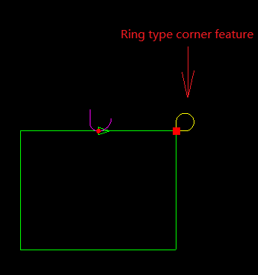
3.3) corner feature of loop
Corner feature of pattern loop defines the cut style at corner of the pattern loop. Please refer to the figure and UML diagram below.
LoopCornerData
CrossCorner
RadiusCorner
ICorner
RingCorner
TabCorner

Slide 19
Class name | Description
LoopCornerData LoopCornerDataList | The corner features for pattern loop.
ICorner CornerBase | Interface and base class for all kinds corner feature.
CornerList | The corner feature list.
CrossCorner | The corner feature which is cross type.
RadiusCorner | The corner feature which is arc type.
RingCorner | The corner feature which is ring type.
TabCorner | The corner feature which is tab type.

Slide 20
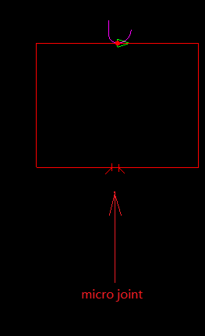
3.4) micro joint feature of pattern loop
Micro joint of pattern loop can keep part still link with sheet after finish cutting the part. Please refer to the figure and UML diagram below.
LoopMicroJoint
MicroJoint

Slide 21
Class name | Description
MicroJoint | The micro joint feature.
MicroJointList | Micro joint feature list.
LoopMicroJoint LoopMicroJointList | Micro joint feature of pattern loop.

Slide 22
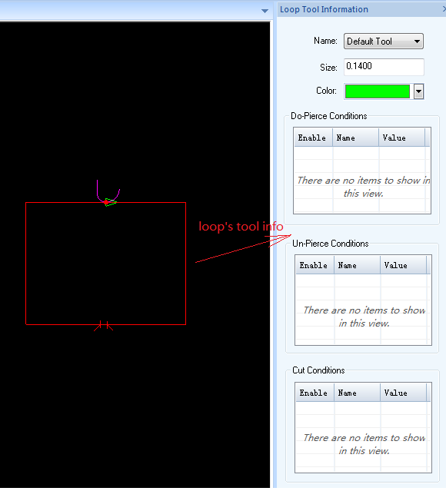
3.5) tool data of pattern loop
Tool data of pattern loop defined the tool used by the pattern loop. Please refer to the figure and UML diagram below.
LoopToolData
ConditionNode

Slide 23
Class name | Description
LoopToolData LoopToolDataList | The tool data of pattern loop.
ConditionNode ConditionNodeList | The cut condition of tool.

Slide 24
3.6) commands
Commands about loop tool
Class name | Description
ConditionNodeAddCommand | The command to add condition node for loop tool.
ConditionNodeDeleteCommand | The command which delete condition node of loop tool.
ConditionNodeModifyCommand | The command which modify condition node of loop tool.
LoopToolChangeCommand | The command which change tool data of pattern loop.
ToolColorModifyCommand | The command which change color of tool.
ToolSizeModifyCommand | The command which change size of tool.

Slide 25
Commands about loop start cut data
Class name | Description
CutDirectionChangeCommand | The command to change the cut direction of loop.
CutSideChangeCommand | The command to change the cut side of loop.
EndCutPtModifyCommand | The command to change the end cut point of loop.
LeadModifyCommand | The command to change lead in/out data of pattern loop.
StartCutPtModifyCommand StartCutPtModifyCommandA | The command to change the start cut point of loop.

Slide 26
Commands about micro joint feature
Class name | Description
MicroJointAddCommand | The command to add micro joint feature.
MicroJointDeleteCommand | The command to delete micro joint feature.
MicroJointLeadAngleModifyCommand | The command to modify lead line angle of micro joint.
MicroJointLeadLengthModifyCommand | The command to modify lead line length of micro joint.
MicroJointLeadModifyCommand | The command to modify lead line of micro joint.
MicroJointPtModifyCommand | The command to modify position of micro joint.
MicroJointWidthModifyCommand | The command to modify width of micro joint.

Slide 27
Commands about corner feature
Class name | Description
CornerAddCommand | The command to add corner feature.
CornerDeleteCommand | The command to delete corner feature.
CornerModifyCommand | The command to modify corner feature.

Slide 28
3.7) business processors
Class name | Description
LoopCutFeatureManager | The management class for loop cut feature.
LoopStartCutProcessor | The class can process start cut data of pattern loop.
LeadManager | This class is management class for lead in/out.
LoopToolManager | This class is management class for loop tool data.
MicroJointMgr | This class is management class for micro joint.
CornerManager | This class is management class for corner feature.

Slide 29
3.8) other classes
Class name | Description
LoopCutFeatureDrawer | Use this class to draw cut features of pattern loop.
LoopCutFeatureLoader | Use this class to load cut features from COE database.
LoopCutFeatureWriter | Use this class to save cut features to COE database.
InterfereCheckTask | This class can check the interference between loop cut features and fix them.

Slide 30
4) clPart module
The clPart module defined the part data structure of COE, part is composed of geometry feature and cut feature. Please refer to the UML diagram below。
Part/PartItem
PartCadData
PartCamData
PatternList
PatternLoopList
LoopCutFeatureList

Slide 31
Class name | Description
Part | Part object consists a cad data and several cam data, each cam data is corresponding to a param config object of an expert item.
PartItem PartItemList | Part item object consists a cad data and a cam data.
PartCadData | Part cad data is the shape definition of part.
PartCamData PartCamDataList | Part cam data consists the cut features of part.
PartLoader PartWriter | These two classes can load/save part data based on COE database.
PartBuilder | This class provided abilities to build part object.
PartDrawer | This class can render part.
PartManager | The management class of part.

